Slide 1
Peering LAN 2.0
Original Presentation:
DENOG14 from:
Bernhard Hahn
Head of Infrastructure
DE-CIX
https://www.youtube.com/watch?v=hvLUmaHVU2A
Adapted for:
MENOG22
Bernd Spiess
Senior Peering Manager & Consultant
DE-CIX
Notes:
this talk is to provide you some insights on our recent EVPN migrations we did, especially in Frankfurt. This presentation was held from my colleague Bernhard at DENOG14 where I share same insights from his presentation.

Slide 2
Agenda
IXP Challenges
Migration Details
Results
Notes:
So let‘s have a quick look at the agenda

Slide 3
IXP Challenges
Notes:
Let´s start looking at the challenges of a large IXP network.

Slide 4
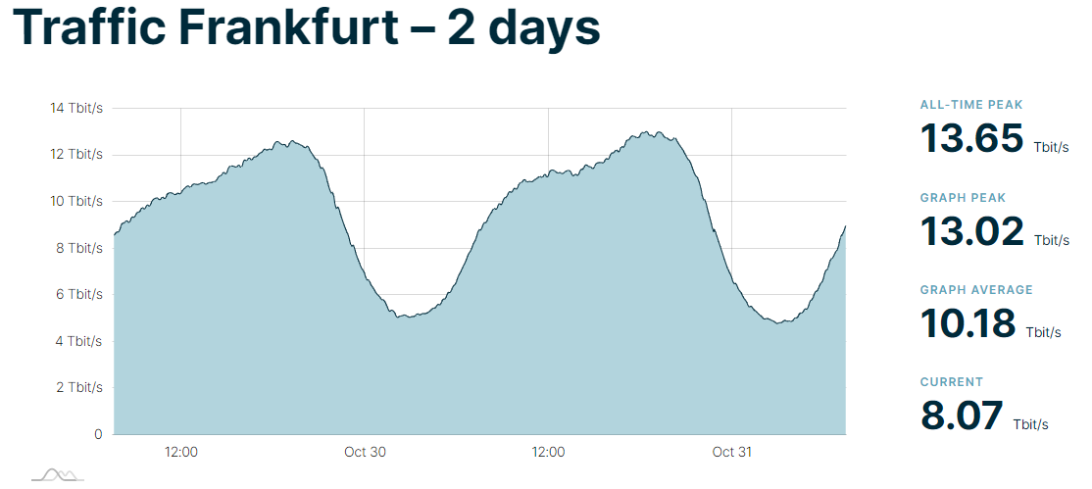
Example: DE-CIX Frankfurt
1120 ASNs
1766 active IPv4 peers
1734 active IPv6 Peers
Notes:
Frankfurt hosts a very large number of peers which are all part of one peering network. Other IXP from us like e.g.: UAE-IX or those in North America or Asia share the same challenge in principle.

Slide 5
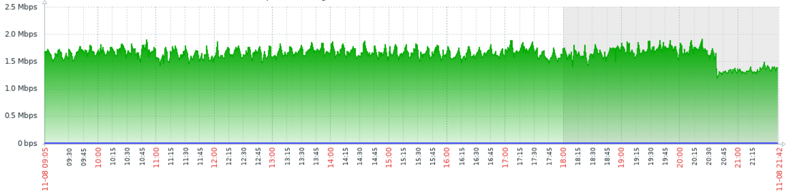
DE-CIX Frankfurt – BUM noise level:
BUM = Broadcast, Unknown Unicast, Multicast
Notes:
BUM means: packets arriving at customers interfaces – needing attention from the CPU. Smaller routers do not like these level of noise. We wanted to change this.

Slide 6

Challenge: ProxyARP/ND
a customer router…
with a wrong configuration …
answering ARP requests …
which does not belong to him…
disturbs layer3 communication
Notes:
Activated proxy ARP/ND is a threat. We monitor this well. Customers might be needed to be shutdown when not fixed. We wanted to do something against this.

Slide 7
Port Security at DE-CIX
Ingress
Egress
BUM (L2, 5Mbit/s)
Broadcast (L2, 1Mbit/s)
IXP
U-Unicast (L2, 1Mbit/s)
Multicast (L2, 1Mbit/s)
Unicast (BE)
Unicast (BE)
Static MAC + MAC ACLs
Notes:
Let's have a look how port security is implemented at DE-CIX to better understand the backgrounds.

Slide 8
Challenge: Long Lasting Flows
VPLS
VPLS
VPLS
Issue: MAC timeout at intermediate nodes
turns unicast into BUM traffic
Notes:
Issue: MAC timeout at intermediate nodes turns unicast into BUM traffic

Slide 9
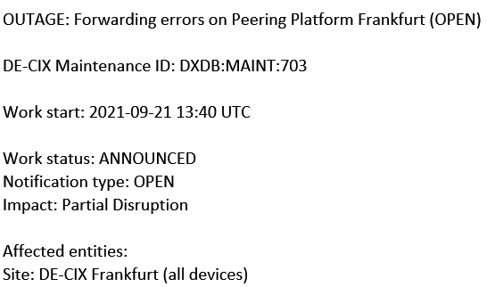
VLAN Loops
IXP
Notes:
VLAN loops is another incident type I wanted to show here.

Slide 10
VLAN Loops
IXP
Customer shortcuts two ports via a single switch.
Notes:
Customer shortcuts two ports via a single switch.

Slide 11
VLAN Loops
Step 1
Routers continuously injecting BUM traffic
IXP
Notes:
Step1: Routers continuously injecting BUM traffic

Slide 12
VLAN Loops
Step 1
Routers continuously injecting BUM traffic
Step 2
BUM traffic in fabric circulating and increasing
IXP
Notes:
Step2: BUM traffic in fabric circulating and increasing

Slide 13
VLAN Loops
Step 1
Router continuously injecting BUM traffic
Step 2
BUM traffic in fabric circulating and increasing
Step 3
BUM traffic level exceeding egress rate limit and blocking valid traffic
IXP
Notes:
Step 3: BUM traffic level exceeding egress rate limit and blocking valid traffic

Slide 14
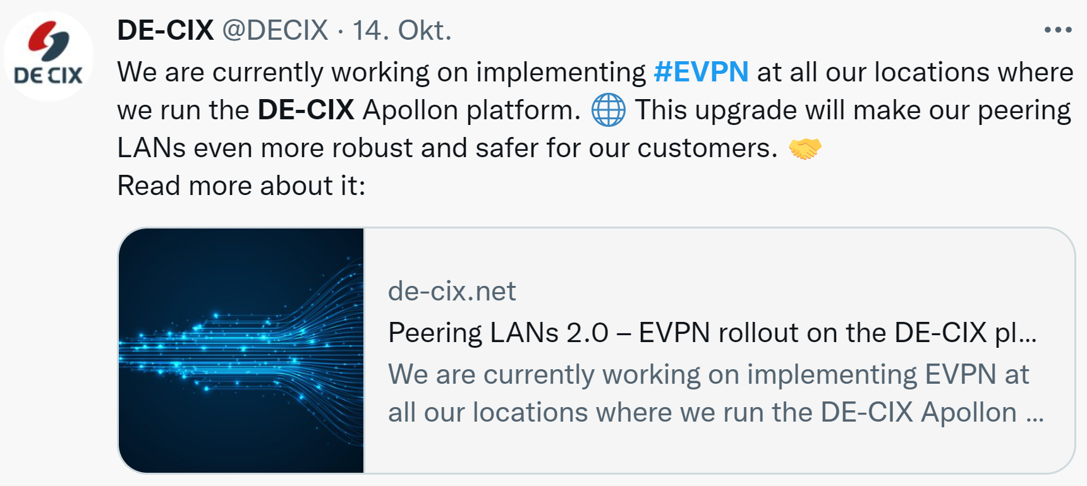
Solution: Global Migration to EVPN
=> will be explained at Migration section

Slide 15
Solution: ARP/ND Agent
RFC 9161
IXP
Bindings
Proxy Agent
ARP Reply
IP – MAC
IP – MAC
IP – MAC
IP – MAC
ARP Request
Notes:
This ARP/ND Agent
Eliminates proxy ARP issues – compromise: just 1 MAC allowed!

Slide 16
Migration

Slide 17


Migration Scenarios
Scenario | Small Steps | Reduce Complexity | Reduce Downtimes
Router by Router
Location by Location
Service by Service
Notes:
We have decided for a Service by Service migration.

Slide 18
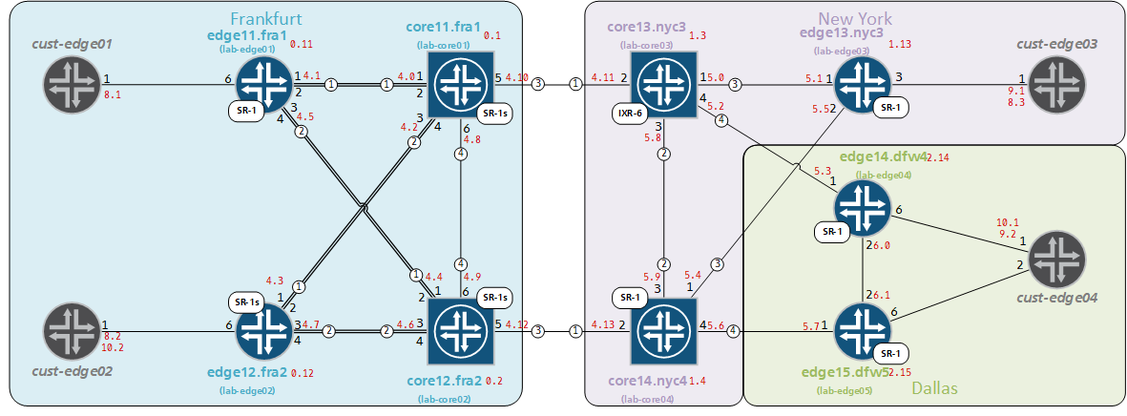
Testing - Network
Notes:
Challenge:
Creating a representative subset of the network
Unfortunately, no test of real traffic amount or all customer gears
Containerlab was just around the corner

Slide 19
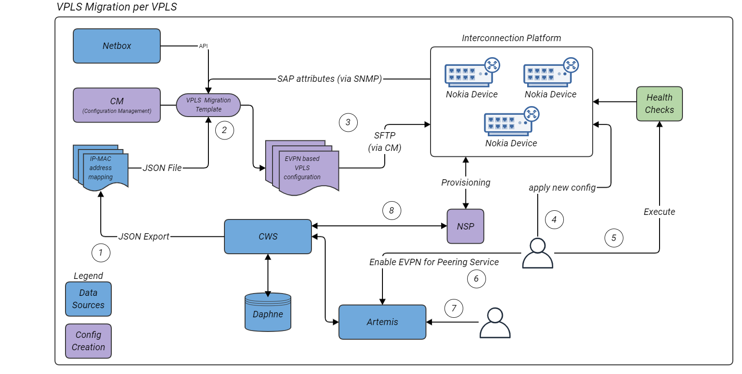
Testing – Configuration Systems
Notes:
Large amounts of connected systems to be tested.
Configurations fully created by tools on base of documented data.
Every code-line had to be correct.
Config deployed via local pre-loaded files –> all at once!

Slide 20
Results

Slide 21
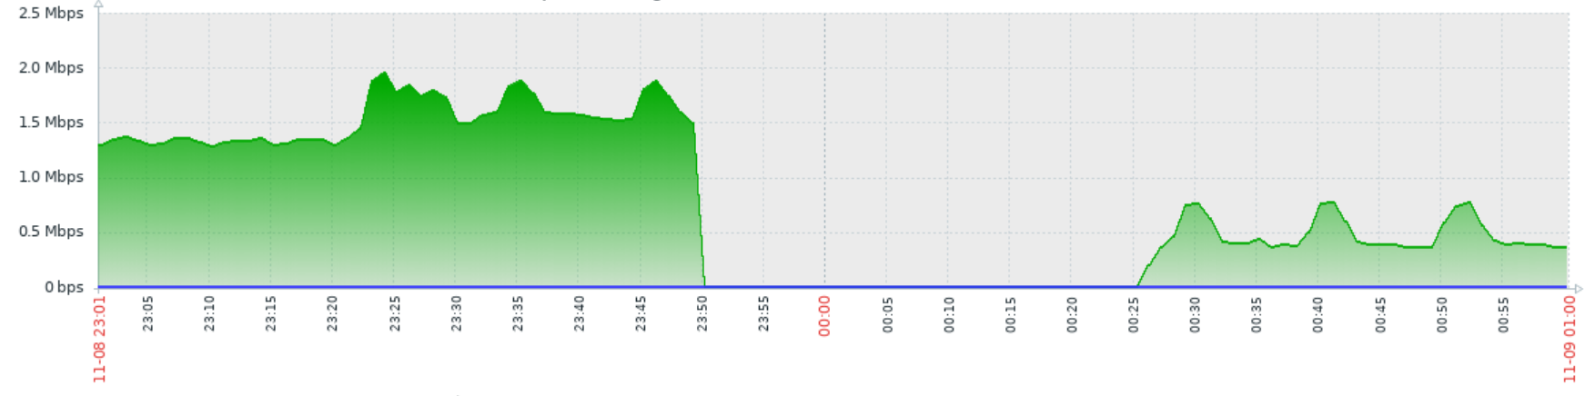
DE-CIX Frankfurt
Broadcast, Unknown Unicast, Multicast Noise (BUM, sliced mirrored)
Notes:
Up to 11.000 lines of code per router in FRA
Per File applied and activated, Applied in 5.5s
No ping lost

Slide 22
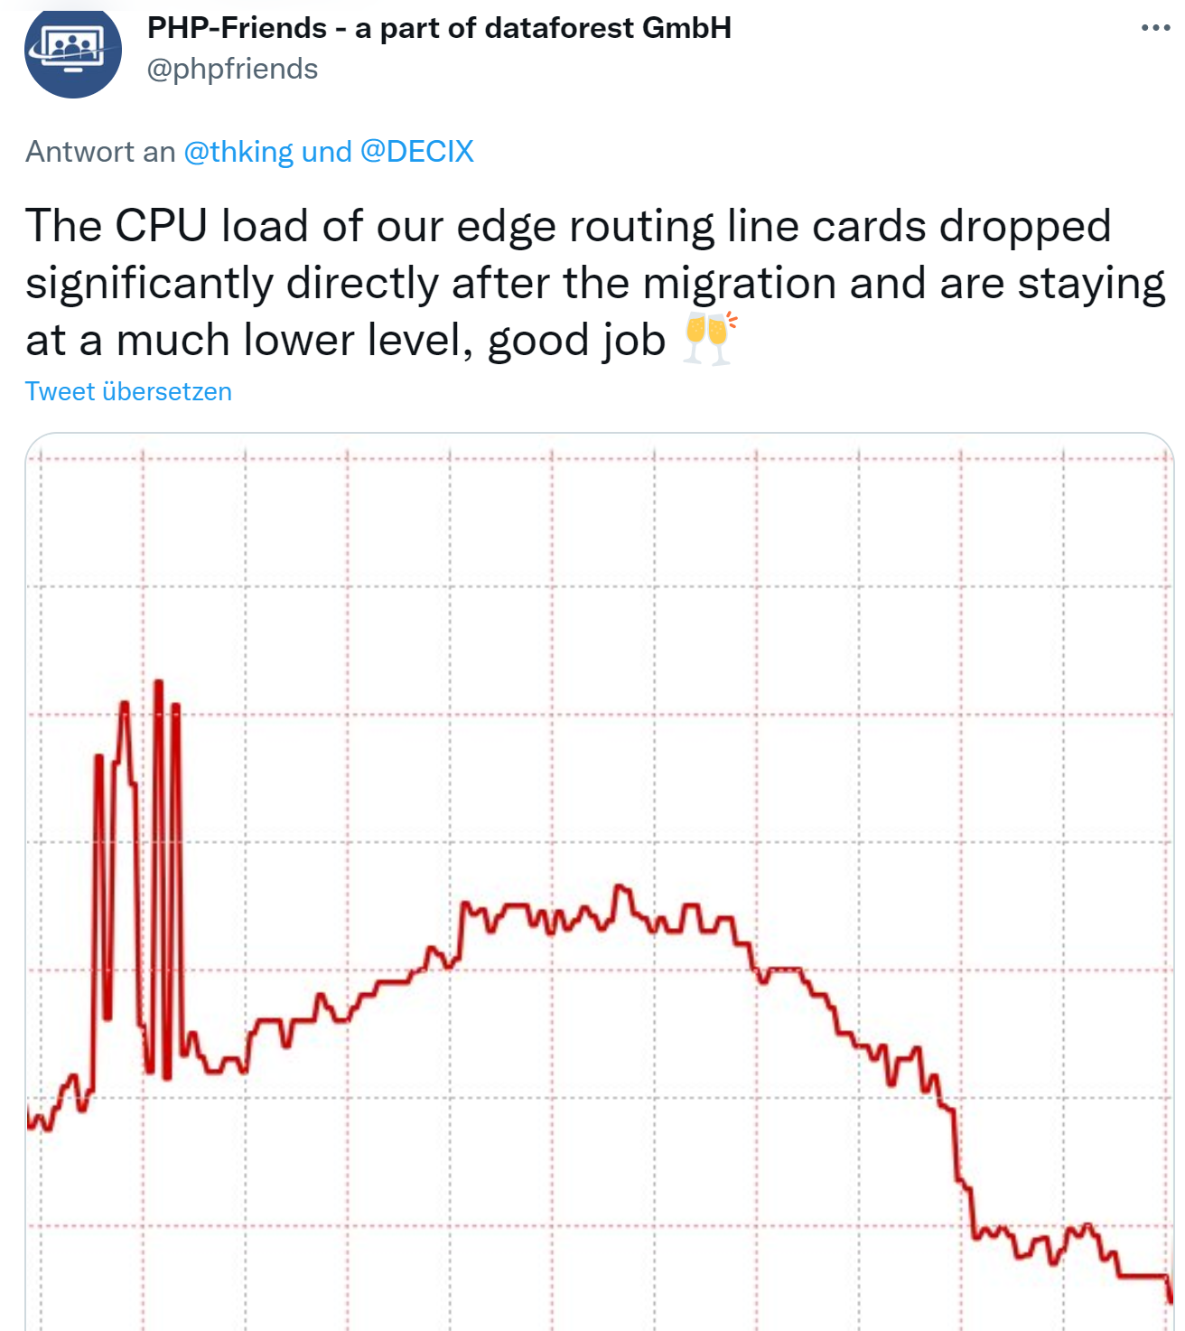
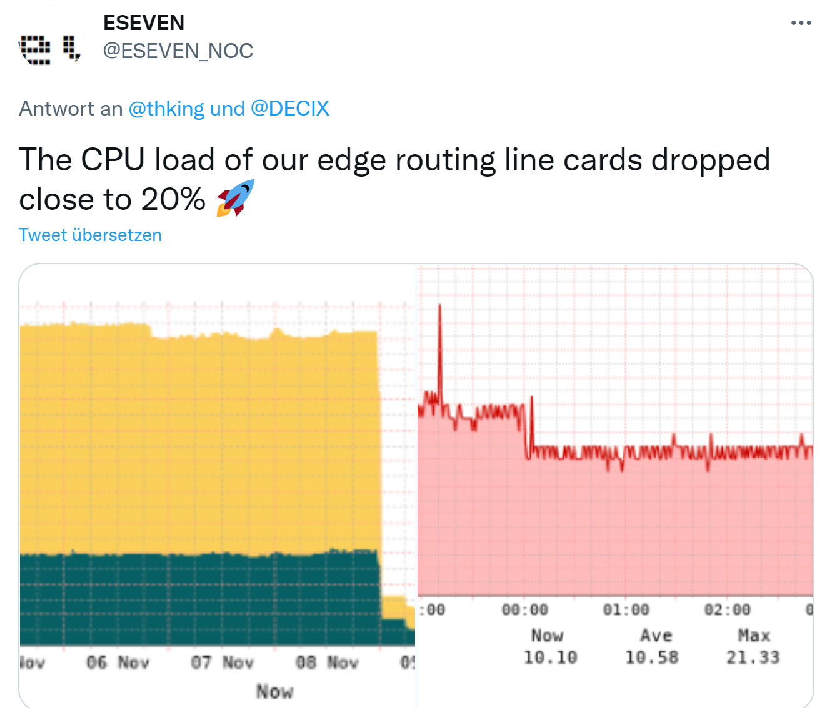
Customer Feedback:

Slide 23
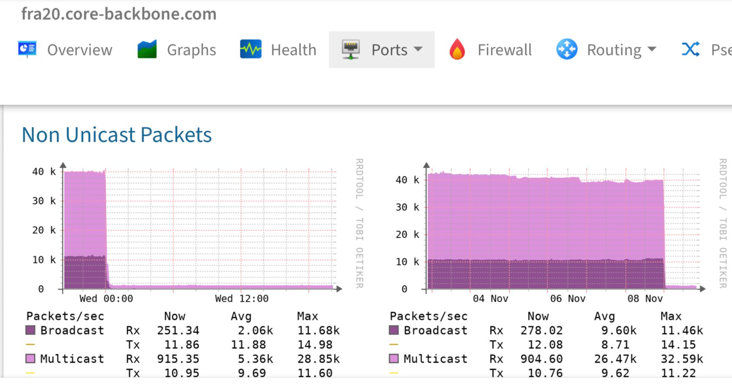
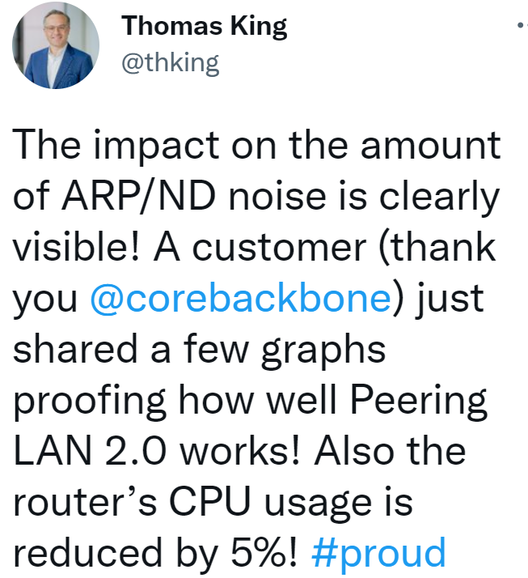
Customer Feedback:

Slide 24
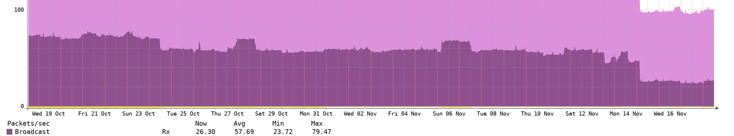

Result of EVPN at UAE-IX:

Slide 25
Bugs & Accidents
  Traffic distribution with LDP entropy labels not working as expected
  IPv6 ND Agent Replies with wrong source IP Address, Software upgrade required

Slide 26
What you can do: as an IXP member
Check Interface / Layer2 / Layer3 Configuration Suggestions:
https://de-cix.net/en/resources/white-papers
https://www.de-cix.net/en/locations/frankfurt/route-server-guide
https://mn-ix.com/technicalDetails.html
https://www.ams-ix.net/ams/documentation/config-guide
https://www.jedix.net/technical-information/

Slide 27
Further Read:
Peering LANs 2.0 – EVPN rollout on the DE-CIX Apollon platform (Thomas King):
https://www.de-cix.net/en/about-de-cix/news/peering-lans-2-0-evpn-rollout-on-the-de-cix-apollon-platform
Original Talk:
DENOG14 / Bernhard Hahn
https://www.youtube.com/watch?v=hvLUmaHVU2A

Slide 28
Thank You!
please LinkedIn me for follow-up talks
Bernd Spiess

